Slide 1
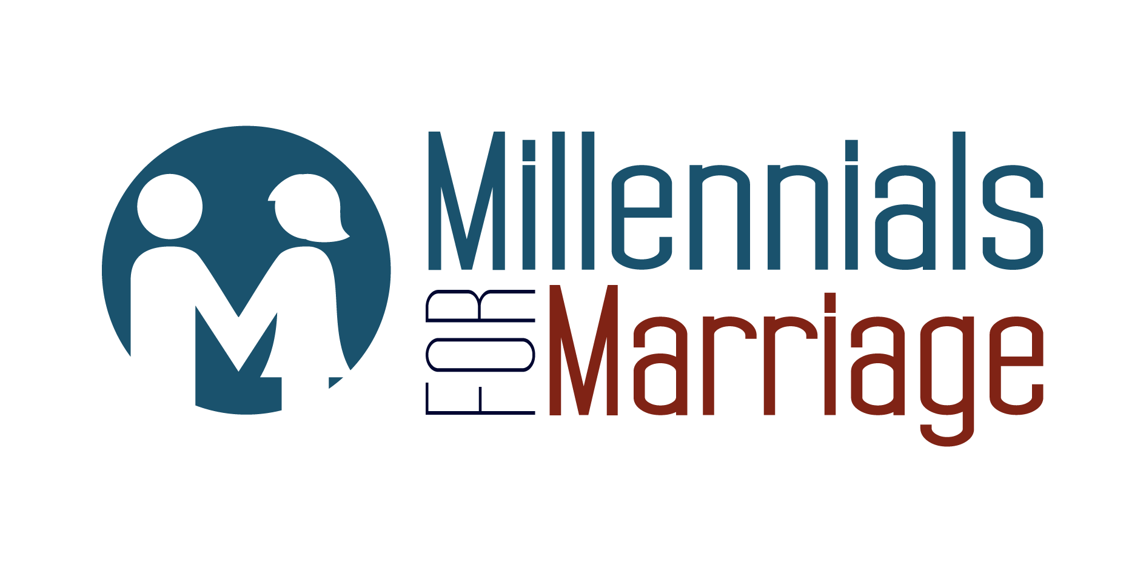
Understanding and Engaging the Millennial Generation

Slide 2
Introducing
Our Vision is to change the prevailing perception of marriage among the Millennial generation by reintroducing the importance of marriage in a relevant way that will ultimately strengthen the very fabric of our American society socially, culturally, spiritually, and economically.
Our Mission is to engage the Millennial generation by starting a new conversation that embraces the importance of covenantal marriage. We seek to do this by engaging Millennials through social media and other media outlets, academia, marriage enrichment education and advocacy campaigns. We seek to educate community, religious, academic, and government leaders on Millennials' current perception of marriage and the consequences it will have on the very fabric of our society. We work with other likeminded groups to create policies that encourage and support healthy marriages that will foster a strong society.
Notes:
Jenn

Slide 3
Who are Millennials?
Born around 1980-2000 – 92 Million
We are the largest and most diverse generation in America Today
15% of us were born abroad (U.S. Census)
Our women are more educated (WH Millennial Report)
We are more likely to attend graduate school compared to previous generations (2015 Millennial Report)
Notes:
Justin

Slide 4
A generation in debt…
We are in debt …71% have some form of student debt.
Average undergrad debt $35,000 alone
Total of just Undergraduate federal and private loan debt - $68 Billion (WSJ – Congrats Class of 2015.)
According to Pew Research: “Millennials are the first in the modern era to have higher levels of student loan debt, poverty, and unemployment, and lower levels of wealth and personal income than their two immediate predecessor generations (Gen Xers and Boomers) had at the same stage of their life cycles.”
Notes:
jenn

Slide 5
An entitled generation?
We are overwhelmed by free choice.
We want instant gratification & recognition for accomplishments both personally and professionally.
Average work time of only 2 years per job - the highest turnover rate of any generation in the current workforce.
91% of us expect to stay in a job for less than three years. That means on average, we will have 15 – 20 jobs over the course of our working lives!” (Meister, 2012).
Notes:
Jenn

Slide 6
Post-Modern, Post-Christian Worldview
Secular Humanism is the prevailing worldview.
Truth is relative & experiential, but not absolute.
Fairness, Equality, Tolerance, and Justice form the generational mantra and societal matrix by which life and culture should be judged and forced to operate.
Anything that is counter to that matrix is now labeled as dangerous, extreme, radical, or passé and should be aggressively eliminated in the name of progress.
Christianity in particular have become a target for radical hostile opposition because the orthodox teaching of the Church is seen as exclusionary, intolerant, or unfair because of spiritual absolutes, moral truths, and social guidelines.
Notes:
Justin

Slide 7
A mixed and jaded view of marriage
70% of Millennials are in favor of same-sex marriage and view it as fair, equal, tolerant, and just.
30% of Millennials claim to have no religious affiliation.
Marriage has become so irrelevant to most Millennials that “almost half support a marriage model that would involve a two-year trial—at which point the union could be either formalized or dissolved, no divorce or paperwork required” (Bennett, 2014).
Nearly 40% of Millennials believe that the “till death do us part” vow should be abolished from wedding vows altogether (Bennett, 2014).
The truth is that 50% of baby boomers (parents of Millennials) are divorced and that has affected the way Millennials view and approach marriage (Schwartz, 2013).
Millennials are cautiously avoiding marriage because of fear that their marriage too will end in divorce. Many still are in need of recovery from emotional pain from their parents divorce.
Notes:
Justin
For the past decade, many "pro-marriage" organizations have been fighting to defend, define, or re-define marriage, which is a noble task. However, the societal institution of marriage itself has become increasingly seen as obsolete and irrelevant in today's culture particularly among Millennials.

Slide 8
The Millennial family…in crisis
Only 26% are married and living in their own home (18-31 Years old).
Many are delaying marriage until 30+. Up from the average age of 23 in 1970.
There is a 50% reduction in young people married and living on their own compared to the 1960’s.
60% are renters, not homeowners who pay property taxes.
Cohabitation has doubled since the mid-1990’s and has risen 1000% in four decades (Fry & Cohn). Cohabiting couples who have a child together are about twice as likely as married couples to break up before their child turns twelve.
59% of millennial woman view cohabitation as a legitimate alternative to marriage (Sliding vs. Deciding).
Notes:
jenn

Slide 9
The summer of love & the winter of lust
As the grandchildren of the sexual revolution, Millennials have embraced and advanced the celebrated the hook-up culture that seeks sexual pleasure over relational intimacy.
This lack of marital commitment is evident by the 40% increase of children being born out of wedlock over the past 20 years.
In return, an enormous amount of single income households, many of which are Millennials, are being created and American families are falling deeper into poverty.
The national center for health statistics revealed that among women under 30 in the United States today, more than half of all births—53%—now occur outside of marriage. (83% of these children will end up in poverty….1/3 of our nation will be in poverty. )
How will this effect the local church and parishes across the country?
Minorities are put at a greater disadvantage. Last year 72% of all births to black women, 66% to first nations women, and 53% to Hispanic women occurred outside of marriage.
Notes:
jenn

Slide 10
We need millennials to marry
We need Millennials to marry.
Research suggests that if family fragmentation were reduced by just 1%, U.S. taxpayers would save an estimated $1.1 billion annually. (Scafidi)
As more and more Millennials choose not to get married, Middle America will become smaller and the lower class will swell larger.
Children who come from a home with married parents have only an 18% chance of living in poverty.
Notes:
Justin

Slide 11
We are working to educate, equip, and engage.
We want to change the conversation and perspective on marriage by educating Millennials about what we are for, rather than what we are against.
We want to use relevant means for communication to equip Millennials for healthy covenantal marriages.
Through our campaigns, we are working towards cultural engagement that highlights the importance and advantages of marriage.
We also want to use peer influence to show real life couples who value marriage and show why marriage matters.

Slide 12
Three Approaches you can take
Approach Marriage Holistically: Changing Millennials perception of marriage starts with healing from the inside out. Think about it, 50% of Millennials come from divorced homes, which causes many to be simply repelled and fearful of the institution. Churches today can create a safe community that models Godly marriages and relationships that bring healing where there is brokenness. The church should begin working with young couples as soon as love blooms while they are dating or engaged. Millennials value mentorship making it a great opportunity for the leaders to guide, support and equip these couples for successful marriages. We have seen religion fail to keep marriages together, but when there is a community of support and open communication, marriage and Godly relationships can thrive.
Approach Marriage Authentically: Did you know that church leaders are in the modeling business? Your role is to model a Godly (not perfect) marriage in an authentic way that changes the negative perception that Millennials have towards marriage. This means that you must make YOUR marriage a priority by investing in your spouse.
Approach Marriage Intimately: Another way to approach marriage that can help change Millennials perception is by having genuine conversations about sex and sexuality that embodies grace and truth. Sex has been perverted in the world and ignored in the church. The church needs to talk about sex! God designed sex to be holy, pure and intimate not perverted, dirty and disingenuous. If the church does not lead in the conversation about sex than the world will.

Slide 13
Our Campaigns that you can get involved in
When looking at our culture today, it is obvious that marriage is undervalued and often broken! Our popular culture paints a picture that celebrates and even applauds dysfunction in the home as the fully accepted norm. We want to see this perception of marriage fixed! This is why Millennials for Marriage decided to create The Hitch Fix. The Hitch Fix helps couples become prepared, equipped, and strengthened for a meaningful and healthy marriage. For those who are dating or engaged, The Hitch Fix will provide the tools you will need to prepare for healthy and long lasting marriage. The Hitch Fix offers you incredible relationship tools, advice, and stories that will strengthen your relationship, refresh your heart and keep you both connected.
Social Media:
The Hitch Fix Instagram/Facebook Campaign
The Hitch Fix Blog
The Hitch Fix Podcast Series (Launching June 2016)
Live Events:
The Hitch Fix Seminar
One Night Stand Events
Special Talks on : The State of the Millennials Union, What to Wear for Amazing Sex (wedding ring), Threesomes Rock (how faith plays a role in marriage), Myths about Millennials and Marriage
Notes:
Jenn

Slide 14
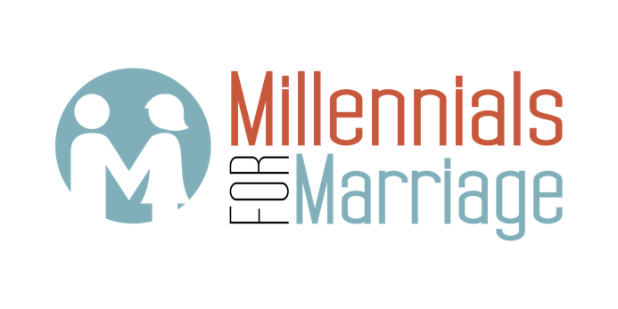
www.Millennialsformarriage.org
Find us on Facebook, Instagram, Twitter
Notes:
Questions and Answers

