Slide 1
SOW-REAPP: A Process of Formation
“…Ever Ancient, Ever New…”

Slide 2
A Look at our Culture…
Being Americans

Slide 3
Leading Each Other to Heaven
What is “heaven”?
What will heaven be like?
What images will you expect to see?
Who will you expect to see?
Who will you not expect to see?
What will you do there?

Slide 4
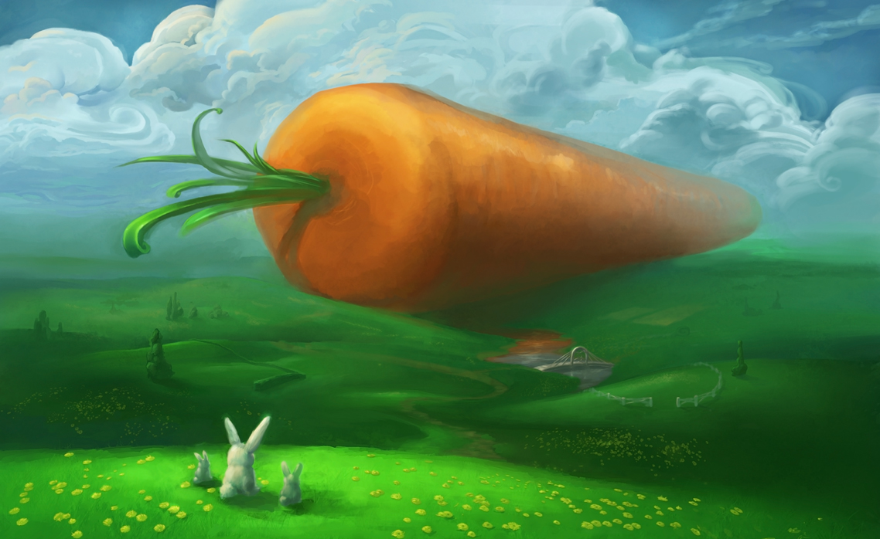
Images of Heaven

Slide 5
We Believe…
To live in heaven is "to be with Christ." The elect live "in Christ," but they retain, or rather find, their true identity, their own name. (CCC 1025)

Slide 6
Post-modern Culture
There is no absolute truth
Truth and error are synonymous
Self-conceptualization and rationalization
Traditional authority is false and corrupt
Ownership
Notes:
From Sherry Weddell, Catherine of Siena Institute, Forming Intentional Disciples seminar

Slide 7
Post-modern Culture
Disillusionment with modernism
Morality is personal
Globalization
All religions are valid
Liberal ethics
Pro-environmentalism
Notes:
From Sherry Weddell, Catherine of Siena Institute, Forming Intentional Disciples seminar

Slide 8
8 Forms of Atheism: Vatican II
1) Disbelief: positively denies existence of God
2) Agnosticism: cannot know anything certain about God: existence or attributes
3) Nominalism:(org in 1400's): language about God is only language, no reality behind the words: God is name for transcendent yearning.
4) Positivism/ Empiricism: cannot know beyond world of external phenomena of our senses and since God is outside of this we cannot prove He exists or we do not need Him.
Notes:
ECCLESIAM SUAM ENCYCLICAL OF POPE PAUL VI, ON THE CHURCH, AUGUST 6, 1964
Gaudium et Spes 19-21
Lumen Gentium 14-16

Slide 9
8 Forms of Atheism: Vatican II
5) Relativism: truth will vary from individual to individual, and culture to culture, God is idealistic concepts that gets expressed in various cultures and individuals, and not an infinite being outside human mind. (Common among anthropologists and sociologists)
6) Humanism: deification of man - man in place of God. (often manifests as practical Pelagianism or Semi-Pelagianism)
7) Mythology: religion is simply a myth - okay for non-thinking peoples
8) Indifference: God does not matter/ caught up in things of this world.
Notes:
ECCLESIAM SUAM ENCYCLICAL OF POPE PAUL VI, ON THE CHURCH, AUGUST 6, 1964
Gaudium et Spes 19-21
Lumen Gentium 14-16

Slide 10
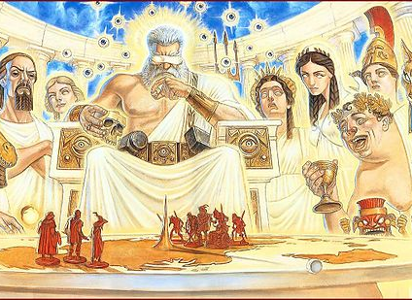
Modern Paganism
Nike- god of all things athletic (Victory)
Hypnos- god of sleep
Adephagia- goddess of foodies (gluttony)
Sophia- goddess of science (knowledge and wisdom)
Chronos- keeper of busy moms (time)
Hera- goddess of the home
Hebe- goddess of video games (youth and play)
Doris- god of fishermen and Artemis- goddess of the hunt
Eros and Aphrodite- gods of porn and adultery (love and beauty)
Google- god of the internet

Slide 11
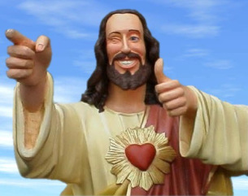
The “Average” Catholic
Moralistic Therapeutic Deism
Notes:
(“Buddy Jesus” from the movie Dogma. Lions Gate Films. Screenplay by Kevin Smith. 1999)
Moralistic Therapeutic Deism is from the book Soul Searching: The Religious and Spiritual Lives of American Teenagers (2005) by Christian Smith and Melinda Lundquist Denton.

Slide 12
SOW-REAPP
Encountering the Real Jesus

Slide 13
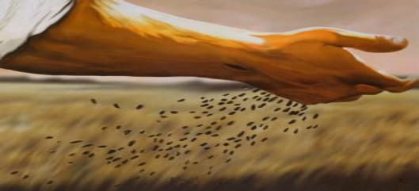
SOW-REAPP
™
A Process of Discernment and Formation for the Experience of a Lifetime

Slide 14
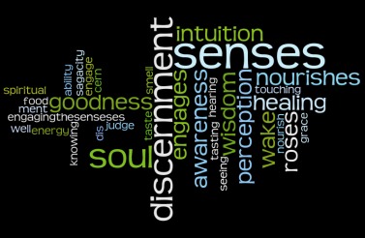
Discernment

Slide 15
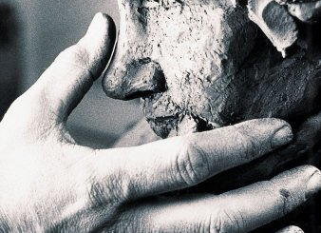
Areas of Formation
Human Formation
Intellectual Formation
Spiritual Formation
Apostolic Formation
Notes:
Areas of Formation for the Laity (from Bishop Hanefeldt of Grand Island)

Slide 16
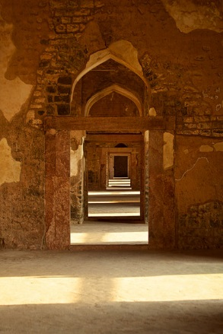
Thresholds of Conversion
Trust
Curiosity
Openness
Seeking
Discipleship
Notes:
Forming Intentional Disciples by Sherry Waddell, published by Our Sunday Visitor

Slide 17
Narrative

Slide 18
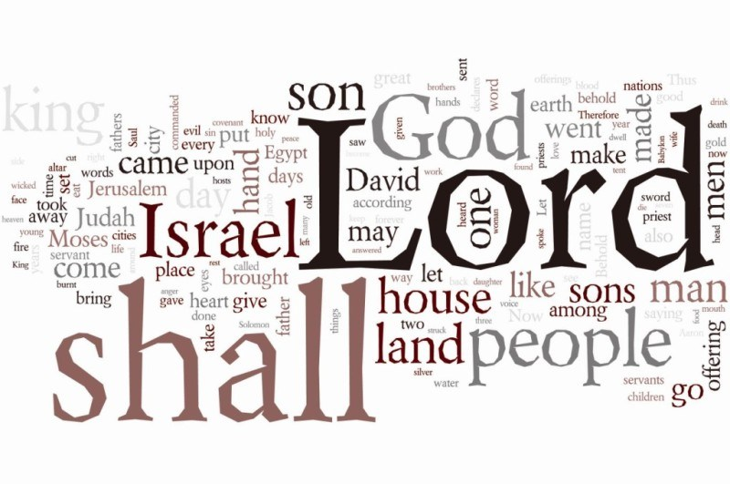
Old Testament and New

Slide 19
Pseudo-Dionysius/ St. John of the Cross
Purification*
(The Purgative Way)^
Enlightenment*
(The Illuminative Way)^
Perfection*
(The Unitive Way)^
*The Celestial Hierarchy ^ The Ascent of Mt. Carmel

Slide 20
SILENCE
OPENNESS
WAITING
RECEIVE
EXAMINE
ASSIMILATE
PRAY
PLAN
Purification
Enlightenment
Perfection
Notes:
SOW-REAPP follows these 8 steps:
Silence - Time in silence to clear away from our minds the distractions of the world.
If I have not spent time reflecting on who I am, I cannot know where I am going, what my purpose is, or why it matters. In silence, I begin to see myself as I really am. If I am honest, I come to know my wants, my needs, joys, my sorrows, and the deepest longings of my own heart. One must come to terms with their own woundedness and weakness in this moment but also be clear about the gifts and virtues which are their strengths.
Openness- Vulnerability and openness to the “other.”
Once I am aware of who I am, I can interact more honestly with others. The deepest and most intimate relationship that we should seek in life is the relationship with Jesus Christ. The Center seeks to help people grow toward wholeness and holiness in life in every aspect of the human person. We remember these aspects with acronym, SPICE: Spiritual, Physical, Intellectual, Communicative, Emotional.
Waiting- Actively waiting for the other.
Relationships can be difficult. Intimacy develops over time. Sacred Scripture is filled with times of waiting for the Lord to come to his people. He comes and goes at his own appointed time, often waiting for us to be properly prepared for his coming. This period of waiting often includes times of confession, penance, and restitution for sin. Regardless, what we are waiting for here is a recognition that there is something better, a readiness for change.
Once those barriers are identified, there is a period of active waiting. This is the time when we purify ourselves of those barriers. Active meditation on those things that draw me away from God and toward the flesh, the world, or the devil is important but the sacrament of reconciliation is very helpful at this point as well.
Receive – Actively receiving the encounter with the other. This should be a kerygmatic proclamation of the Gospel.
At this point in the process, it is our hope that the individual has decided to go on an intentional search. They have recognized a deficiency (or several) in their life and they begin to actively look for the healing that Christ offers. They are ready to receive in a new way. They begin to seek out Jesus. Their seeking leads them to an encounter in which they can grow closer to Him. Receiving requires active engagement, study, and intentional awareness. True reception of the other becomes possible when one takes on a spirit of humility, placing even and especially the poor on a higher status than myself. We understand our shared humanity as pilgrims on a journey toward Heaven.
Examine- Time to reflect on what is received. IT is in this process of EXAMEN that the experience of the Gospel can lead to discipleship.
We have received an experience of the light, but did we recognize it for what it was? While experience is a great teacher, her lessons are typically forgotten without time spent reflecting on the experience. The center uses a process of spiritual self-examination called “examen.”
Assimilate- Understanding and integration of one’s own story with the story of salvation history. (Living as a disciple)
In Christianity, the term metanoia is often used to express what is meant here. This involves an intentional turning away from the darkness in one’s life and turning toward the light of Jesus Christ. Jesus hopes to lead us on a new path. Will we follow him or go another direction? This is the moment where we choose. Will our story embrace the possibility of receiving the blessing that God wishes to give us, or will we seek a blessing of our own making?
Pray- Modeling and practice of prayer
Prayer at the center is seen as a means to give intentional voice to the desires of one’s heart and mind, and discern the next right step on one’s path in the presence of God the Father, His Son Jesus Christ and with the power of the Holy Spirit.
Plan- Develop practical steps to change one’s life in accord with this new experience. (Becoming an apostle)
One should look for practical steps to make a permanent change in direction. Even the Gospels tell us it is easy to begin on a new path, but difficult to complete the journey. A good plan, followed with discipline and accountability is a great way to overcome any obstacle.

Slide 21
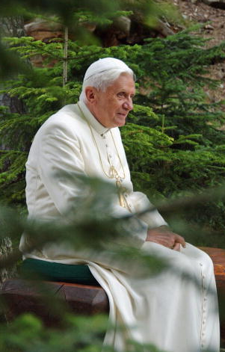
Silence
"In silence, we are better able to listen to and understand ourselves; ideas come to birth and acquire depth... Deeper reflection helps us to discover the links between events that at first sight seem unconnected...."
- Pope Emeritus Benedict XVI
Notes:
Silence- Time in silence to clear away from our minds the distractions of the world

Slide 22
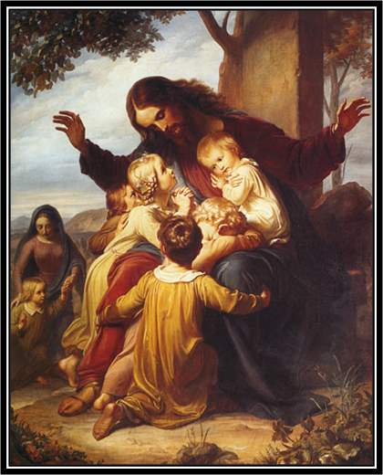
Jesus is
Speaking
to Us
Here…
Now
Notes:
SOW-REAPP speaks to the longing of our hearts – to know and be known.

Slide 23
Openness
How do we welcome the tenderness of God? Do I allow myself to be taken up by God, to be embraced by him, or do I prevent him from drawing close? “But I am searching for the Lord” – we could respond.
Nevertheless, what is most important is not seeking Him, but rather allowing Him to find me and caress me with tenderness. The question put to us simply by the Infant’s presence is: do I allow God to love me?
-Pope Francis, Christmas Eve Homily 2014
Notes:
Openness- Vulnerability and openness to the “other.”

Slide 24
Waiting
Let us think back to that dark moment when the first crime of humanity was committed,... But God, who placed a sense of expectation within man made in his image and likeness, was waiting...
Through the course of history, the light that shatters the darkness reveals to us that God is Father and that his patient fidelity is stronger than darkness and corruption….He is always there, like the father in the Parable of the Prodigal Son, waiting to catch from afar a glimpse of the lost son as he returns.
-Pope Francis, Christmas Eve Homily 2014
Notes:
Waiting - Actively waiting for the other.

Slide 25
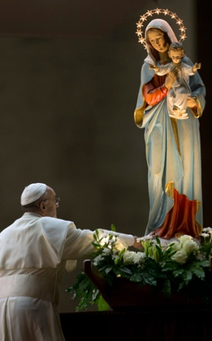
Receive
On this holy night we contemplate the Nativity scene: there “the people who walked in darkness have seen a great light”. People who were unassuming, open to receiving the gift of God, were the ones who saw this light. This light was not seen, however, by the arrogant, the proud,… who were closed off to others. Let us look to the crib and pray, asking the Blessed Mother: “O Mary, show us Jesus!”
-Pope Francis, Christmas Eve Homily 2014
Notes:
Slide 21 Receive - the intimate encounter with the “other.”

Slide 26
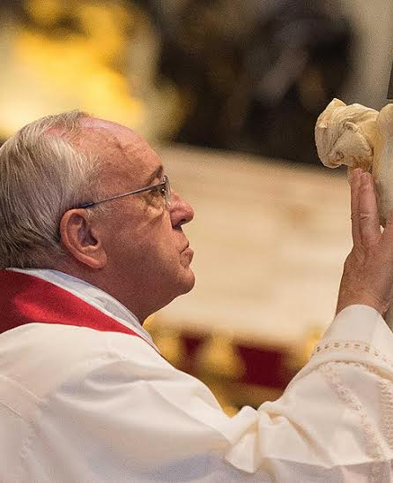
Examine
…Memory has a fundamental role..: memory of grace, the memory mentioned in Deuteronomy, the memory of God’s works that are the basis of the covenant between God and the people. It is this memory that makes me his son and that makes me a father, too.
-Pope Francis on Prayer
Notes:
Slide 2: Examine (Examen)- Time to reflect on what is received.

Slide 27
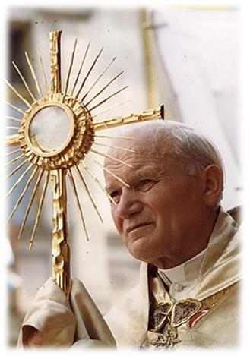
Assimilate
The Christian family's sanctifying role is grounded in Baptism and has its highest expression in the Eucharist, to which Christian marriage is intimately connected… In this sacrifice of the New and Eternal Covenant, Christian spouses encounter the source from which their own marriage covenant flows, is interiorly structured and continuously renewed.
-Pope Saint John Paul II(FC 57)
Notes:
Assimilate- Understanding and integration of one’s own story with the story of salvation history. Living in covenant rel;ationship with God.

Slide 28
His Story IS Your Story (Lectio Divina)
Notes:
The first form of prayer is called Lectio Divina, (Latin for Divine Reading) developed by Guigo the Carthusian

Slide 29
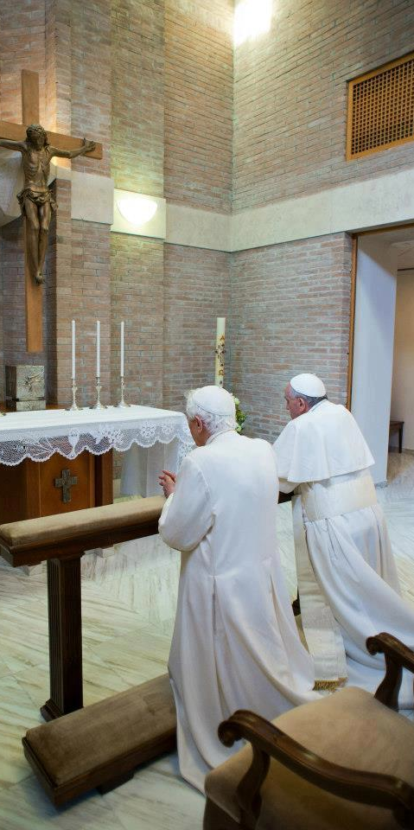
Pray
“The Lord tells us: 'the first task in life is this: prayer.' But not the prayer of words, like a parrot; but prayer of the heart: gazing on the Lord, hearing the Lord, asking the Lord,”
-Pope Francis
“Learn to pray together, in the intimacy of the home, so that your love may be ever truer, ever more fruitful and long lasting.”
-Pope Benedict XVI
Notes:
Pray - Modeling and practice of prayer

Slide 30
Intimacy
Intimacy comes from self revelation

Slide 31
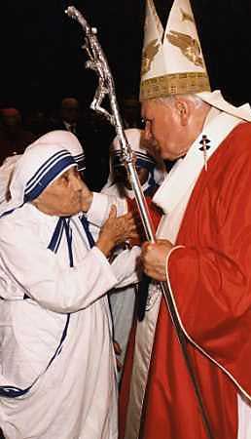
Plan
“The Word of God, by taking on our human nature in all things save sin (Hebrews 4:15), manifests the Father's plan by revealing to each human person the way to realize fully his or her vocation. Thus, Jesus not only reconciles man with the Father, but also reconciles man with himself and thus reveals his true nature.”(GS22) With these words the Synod Fathers, taking up the teaching of the Second Vatican Council, reaffirmed that Jesus is the way which leads to full personal realization, culminating in the definitive and eternal encounter with God. “I am the way, and the truth, and the life; no one comes to the Father, but by me” (John 14:6)
-Pope Saint John Paul II(EA 10)
Notes:
Plan- Develop practical steps to change one’s life in accord with this new experience.

Slide 32
Remember the Family!
“It is within a family that one experiences for the first time how the human person was not created to live closed up in himself, but in relationship with others. ...The family is the first place people become aware that the world does not revolve around just themselves.
It’s in the family one learns that the driving force is not egoism, but self-giving, and it is in the family that the light of peace begins to light up in the heart, a light that is meant to radiate out into the world.”
Pope Benedict XVI in Milan, Italy, 7th World Meeting of Families

Slide 33
Nazareth Hall 1.888.800.8352
3300 North 60th Street 402.551.9003
Omaha, Nebraska 6814-3402 Family.ArchOmaha.org

